Slide 1
Top-line findings on smoking in Wales from the Smoking Toolkit Study
Vera Buss, Robert West, Loren Kock, Dimitra Kale, Jamie Brown

Slide 2
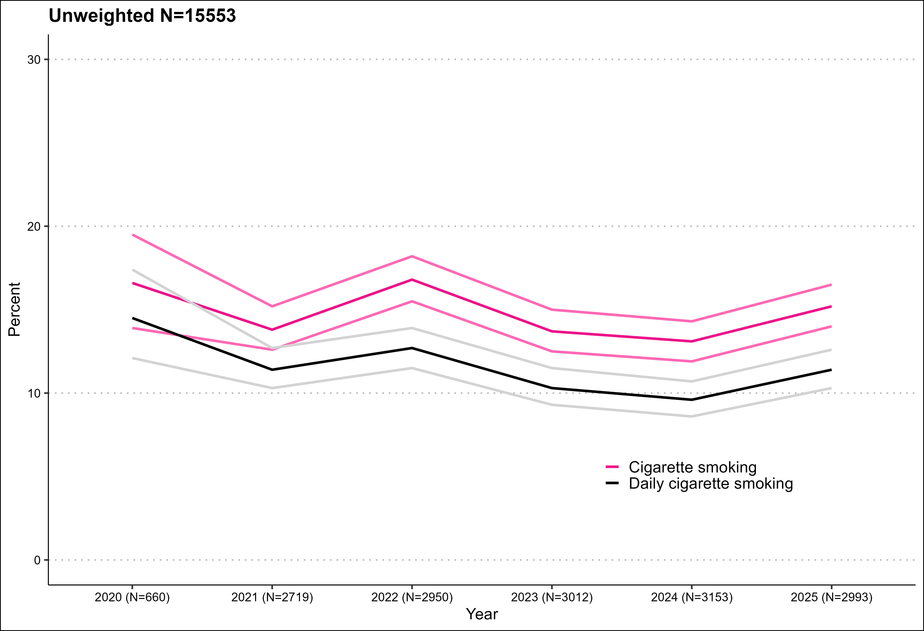
Cigarette smoking prevalence
Graph shows prevalence estimate and upper and lower 95% confidence intervals

Slide 3
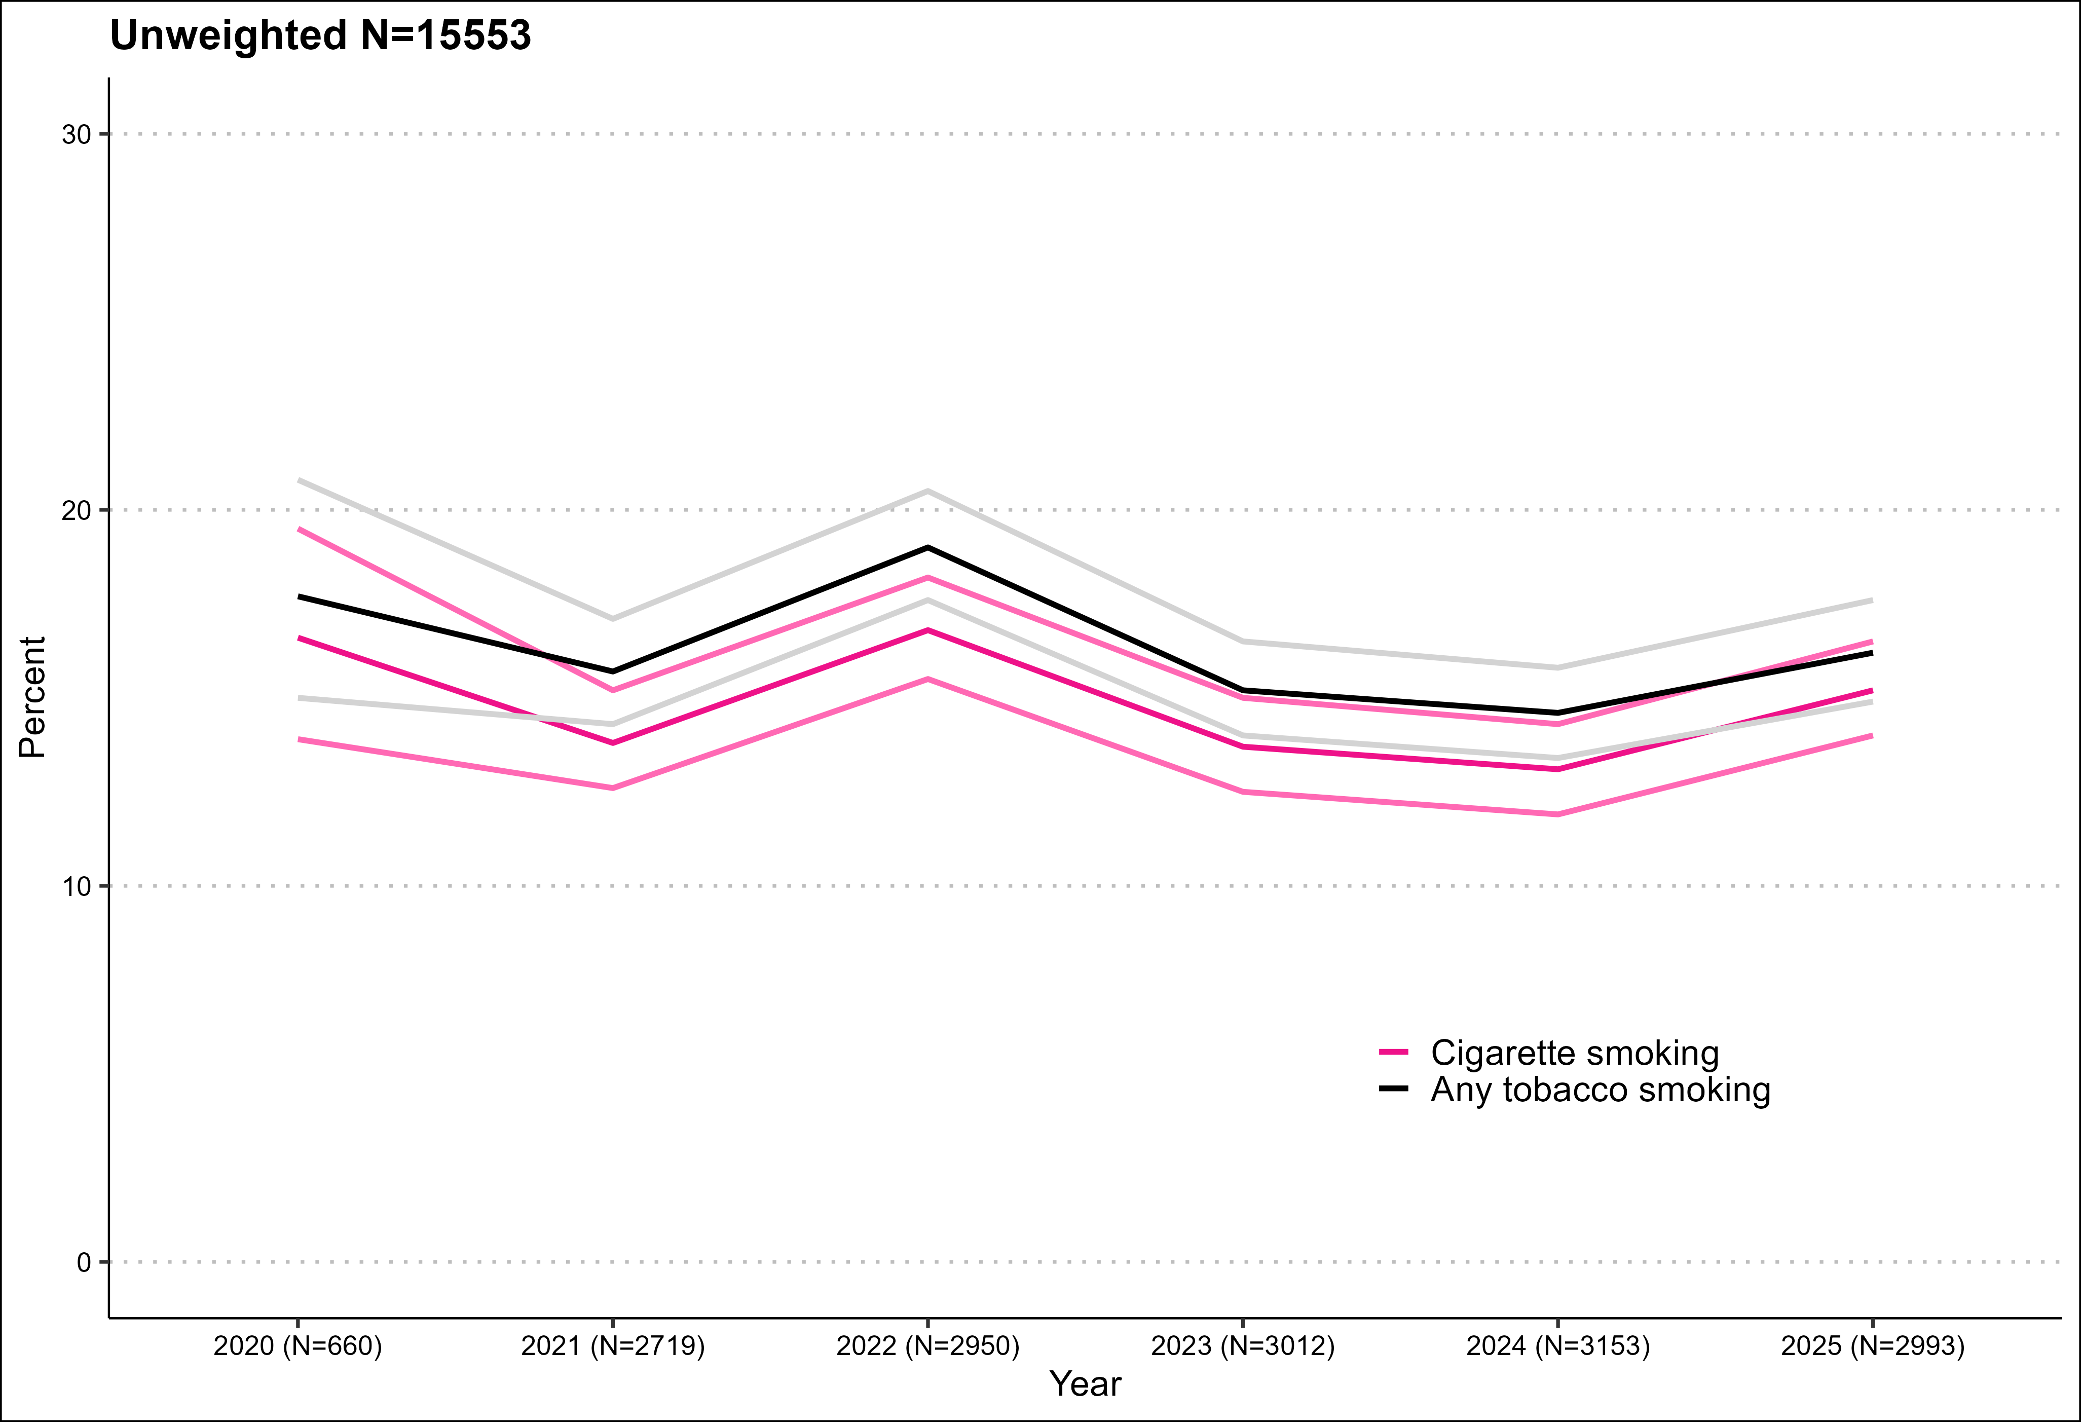
Smoking prevalence
Graph shows prevalence estimate and upper and lower 95% confidence intervals

Slide 4
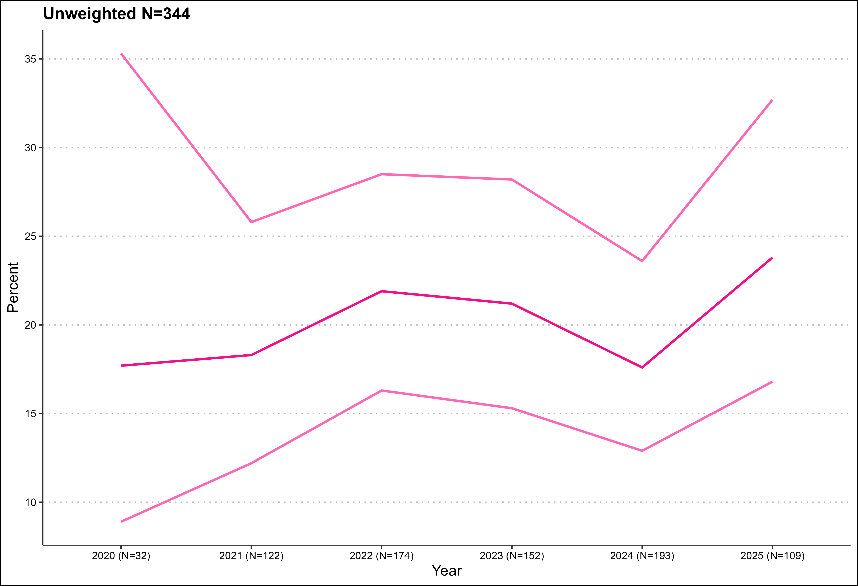
Cigarette smoking prevalence 18-21-year-olds
Graph shows prevalence estimate and upper and lower 95% confidence intervals

Slide 5
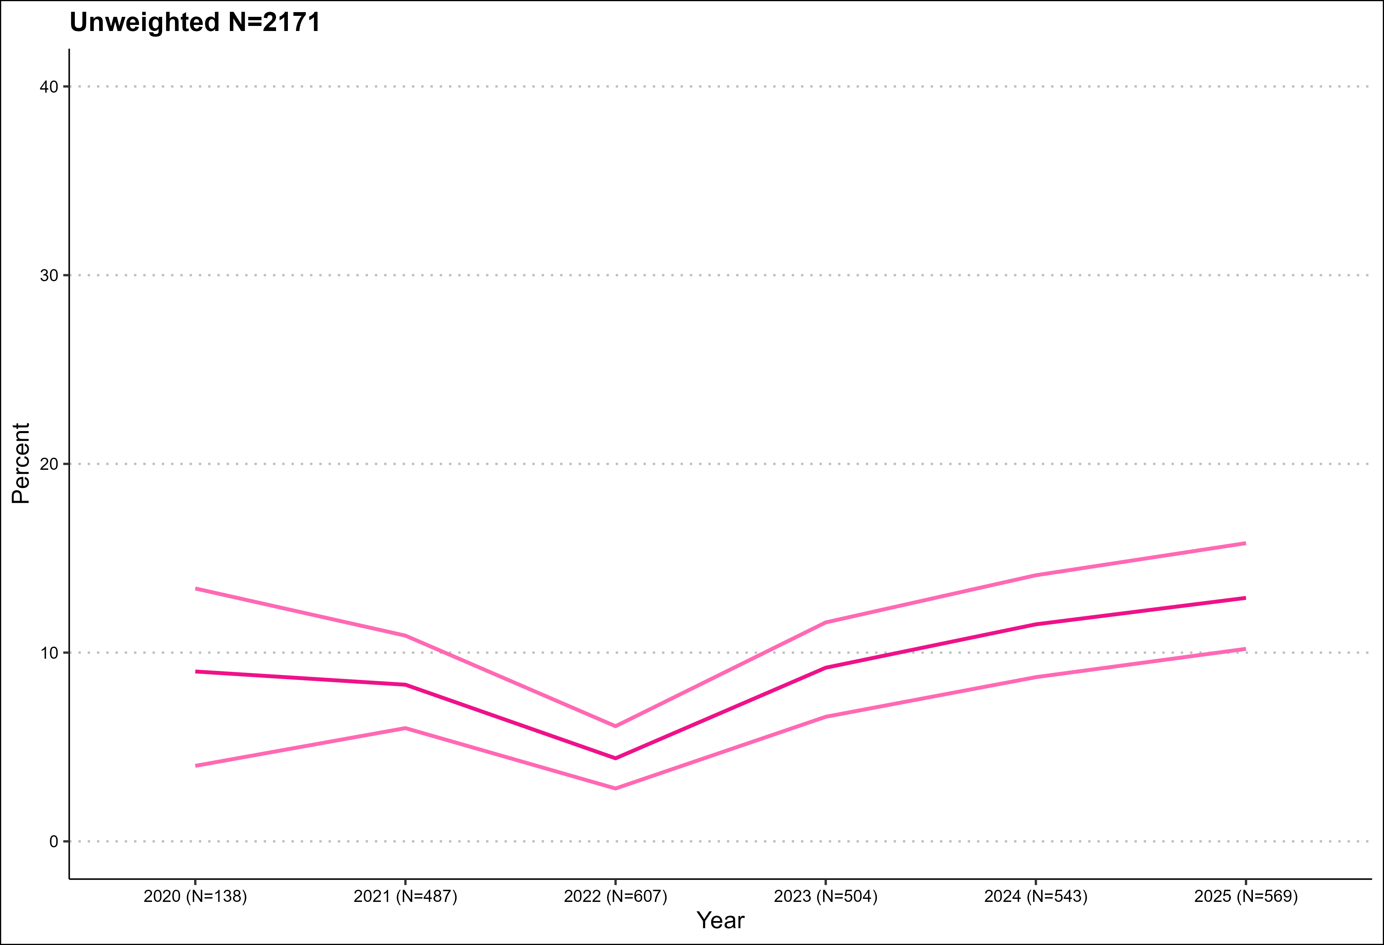
Stopped smoking in past 12 months
Graph shows prevalence estimate and upper and lower 95% confidence intervals

Slide 6
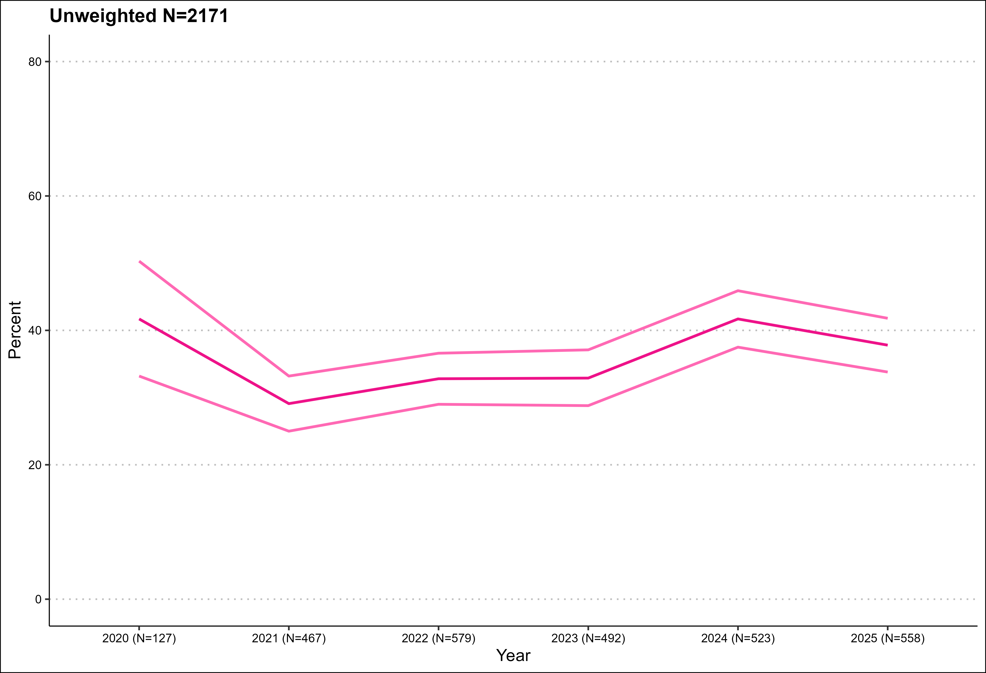
Tried to stop smoking in past year
Graph shows prevalence estimate and upper and lower 95% confidence intervals

Slide 7
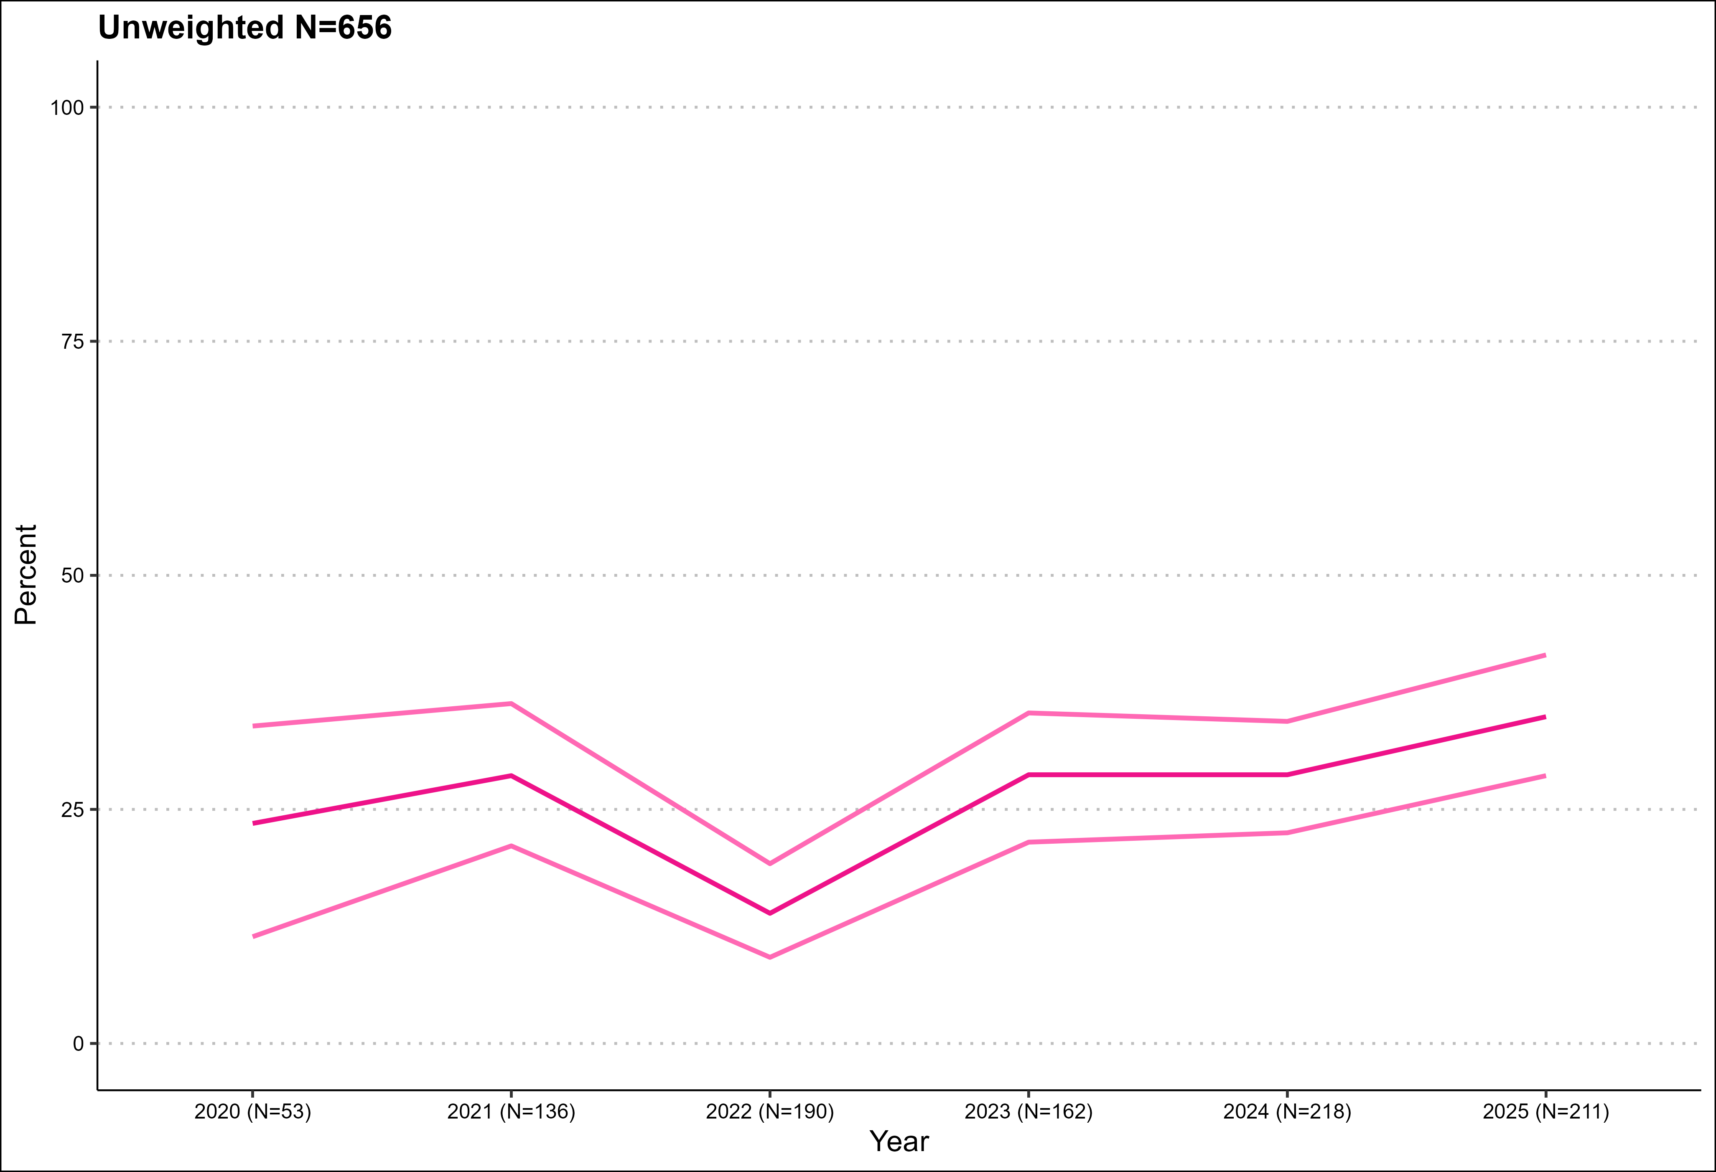
Success rate in stopping in those who tried
Graph shows prevalence estimate and upper and lower 95% confidence intervals

Slide 8
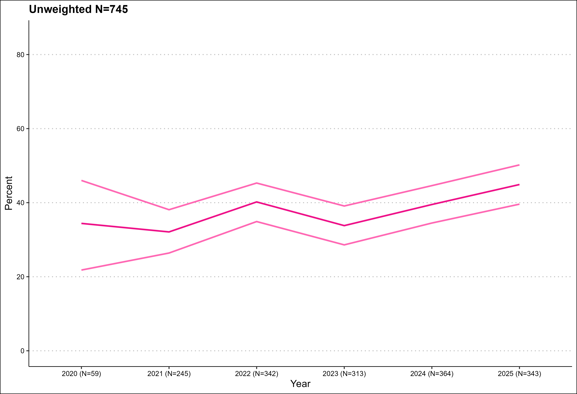
Uptake: prevalence of ever smoking in those aged 18-24
Graph shows prevalence estimate and upper and lower 95% confidence intervals

Slide 9
Methods
Monthly household surveys of representative samples of 300 adults (16 years and older years old in Wales)
  Due to pandemic, surveys are conducted by telephone (rather than face-to-face) and among adults aged 18 and over between April 2020-December 2021.
Fieldwork by IPSOS MORI
Sample weighted to match population in Wales on key socio-demographics
For more information (including data underlying each graph) visit www.smokinginwales.info

